Slide 1

WELCOME
TO
THE CLASS

Slide 2



Slide 3
Teachers’ Identification
1. Khalid Hossain
Lecturer, English
Moghia Salehia Alim Madrasha,
Kachua, Bagerhat.
Index- 2028580
Phone- 01917947760, E-mail- khalid.apu@gmail.com

Slide 4

Lesson Address
Class : Eleven (11), Unit # 6
Subject : English 1st Paper
Topic : How the environment is polluted
Time : 45 minutes
Date : 31st May 2013

Slide 5

Objectives
After this lesson students will be able to
1. Two passages about environment pollution
2. Discussed some pollution related question
3. Designed a questionnaire
4. Compare different pollutions
5. Analyze & explain causes of pollution
6. Sorting out solutions or remedies

Slide 6

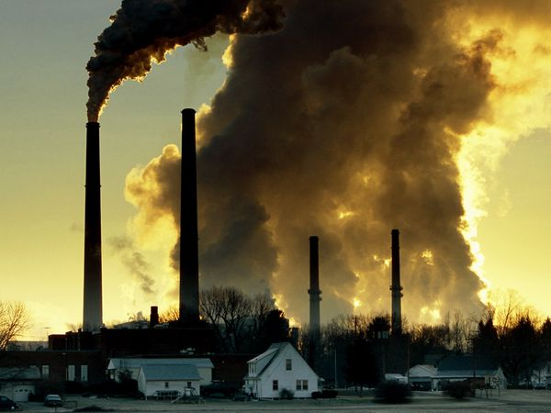
Lesson warm up pictures
Describe the picture.

Slide 7
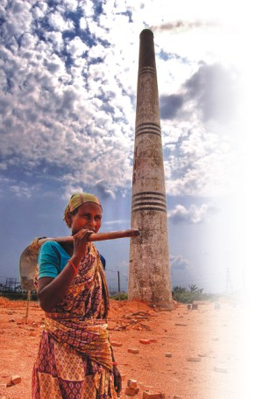
Lesson warm up pictures
Describe the picture.

Slide 8
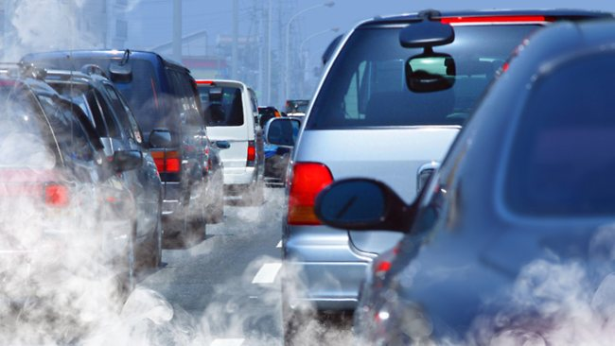
Lesson warm up pictures
Describe the picture.

Slide 9
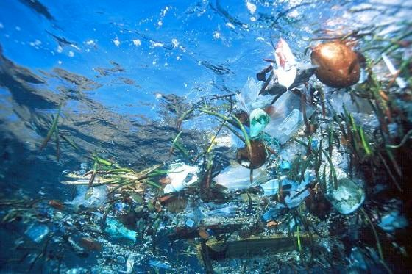
Lesson warm up pictures
Describe the picture.

Slide 10
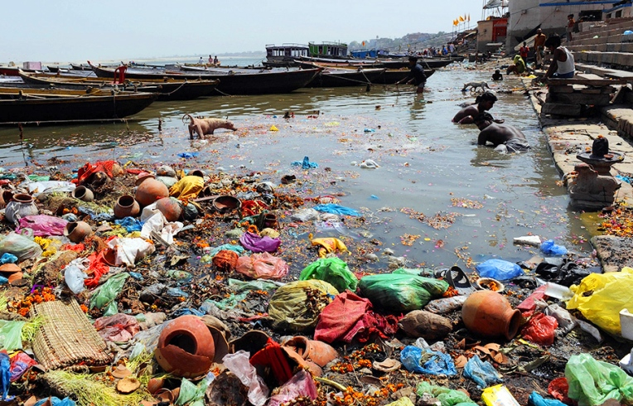
Lesson warm up pictures
Describe the picture.

Slide 11
TOPIC
HOW THE ENVIRONMENT IS POLLUTED

Slide 12

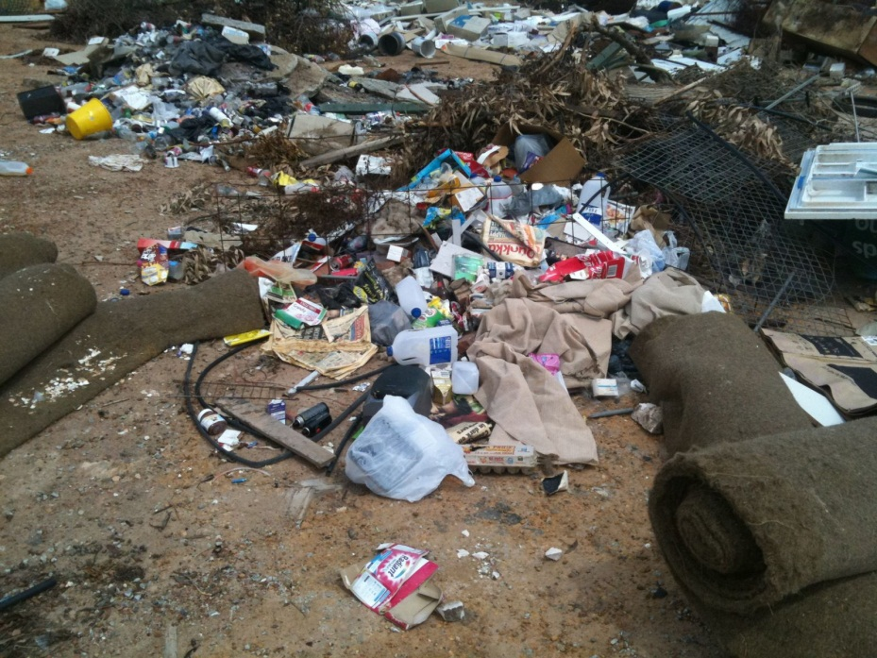
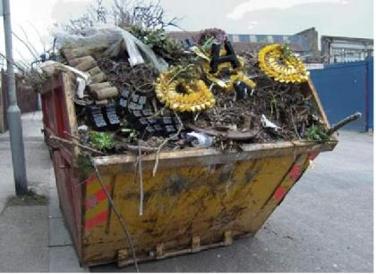
A. Domestic Rubbish
a. What can you see in the picture 1?
b. Describe the picture 2.
c. Analyze the pictures.

Slide 13
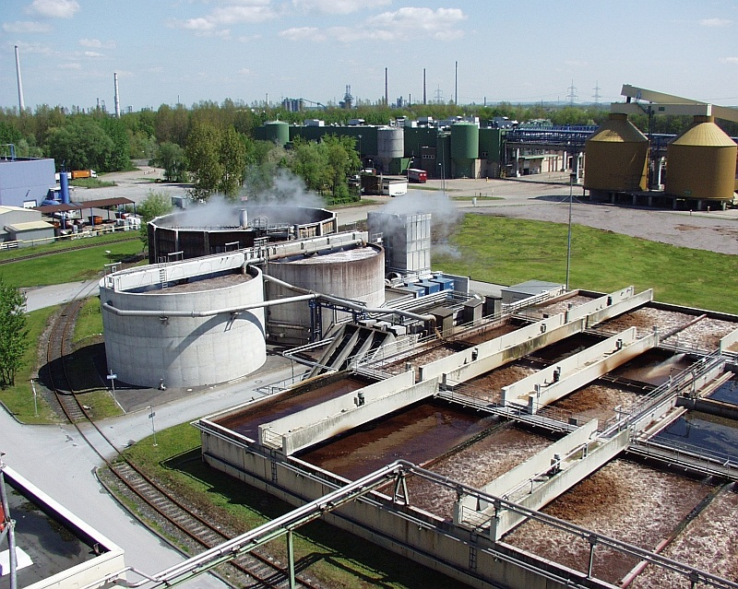
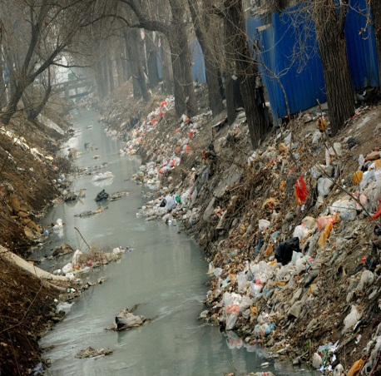
B. Industrial Waste
a. What can you see in the picture 1?
b. Describe the picture 2.
c. Analyze the pictures.

Slide 14
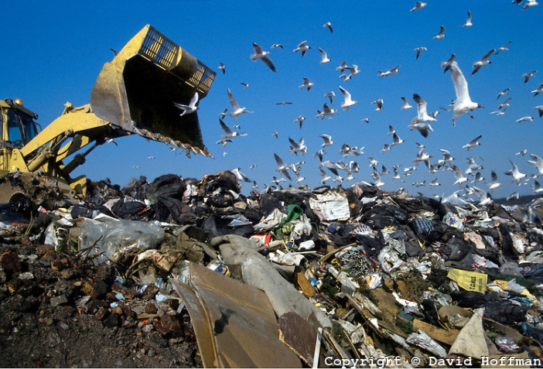
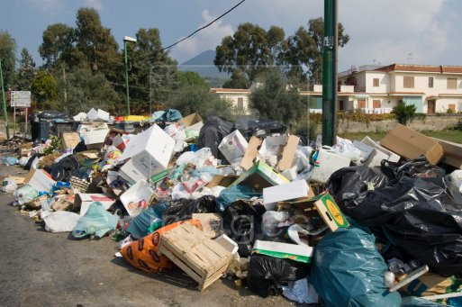
C. Lack of dumping locations
a. What can you see in the picture 1?
b. Discuss the picture 2.
c. Explain the causes & solutions in pictures.

Slide 15

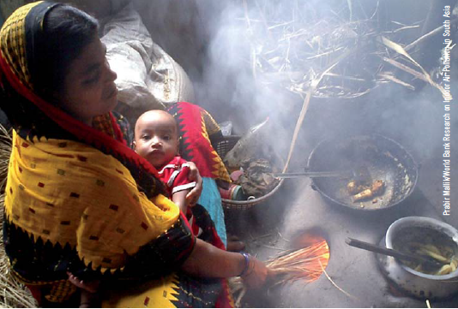
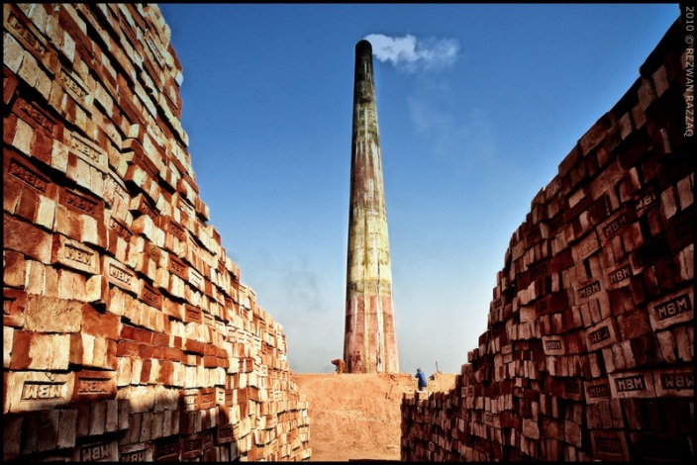
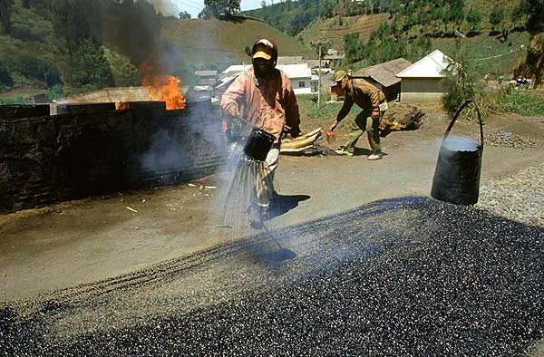
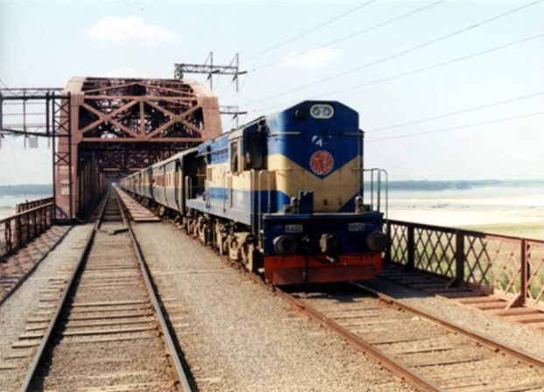
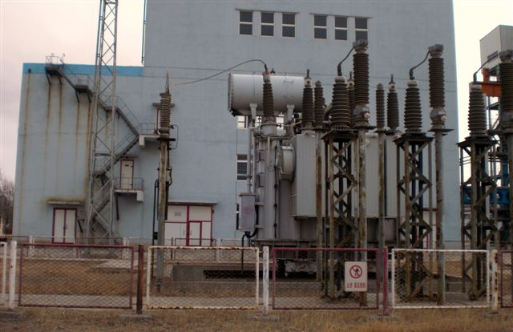
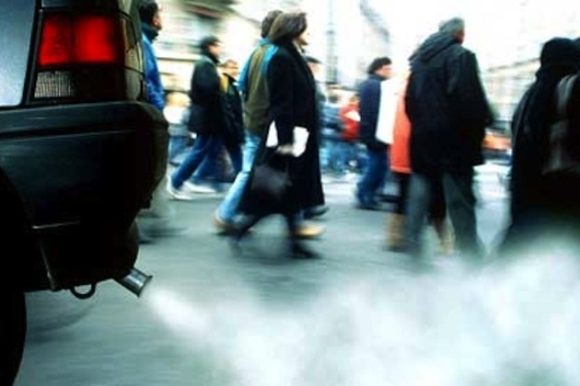
D. Causes of air pollution (Smoke)
a. What can you see in the pictures?
b. Discuss the cause & solution of air pollution.
c. Compare & contrast these pictures.

Slide 16
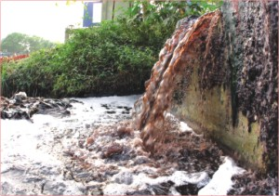
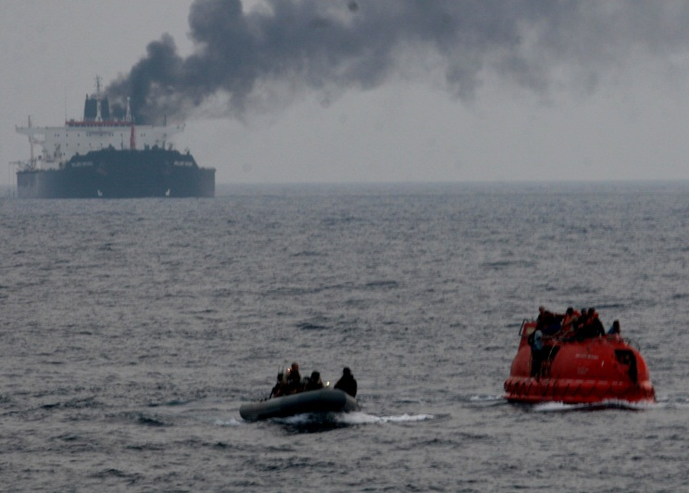
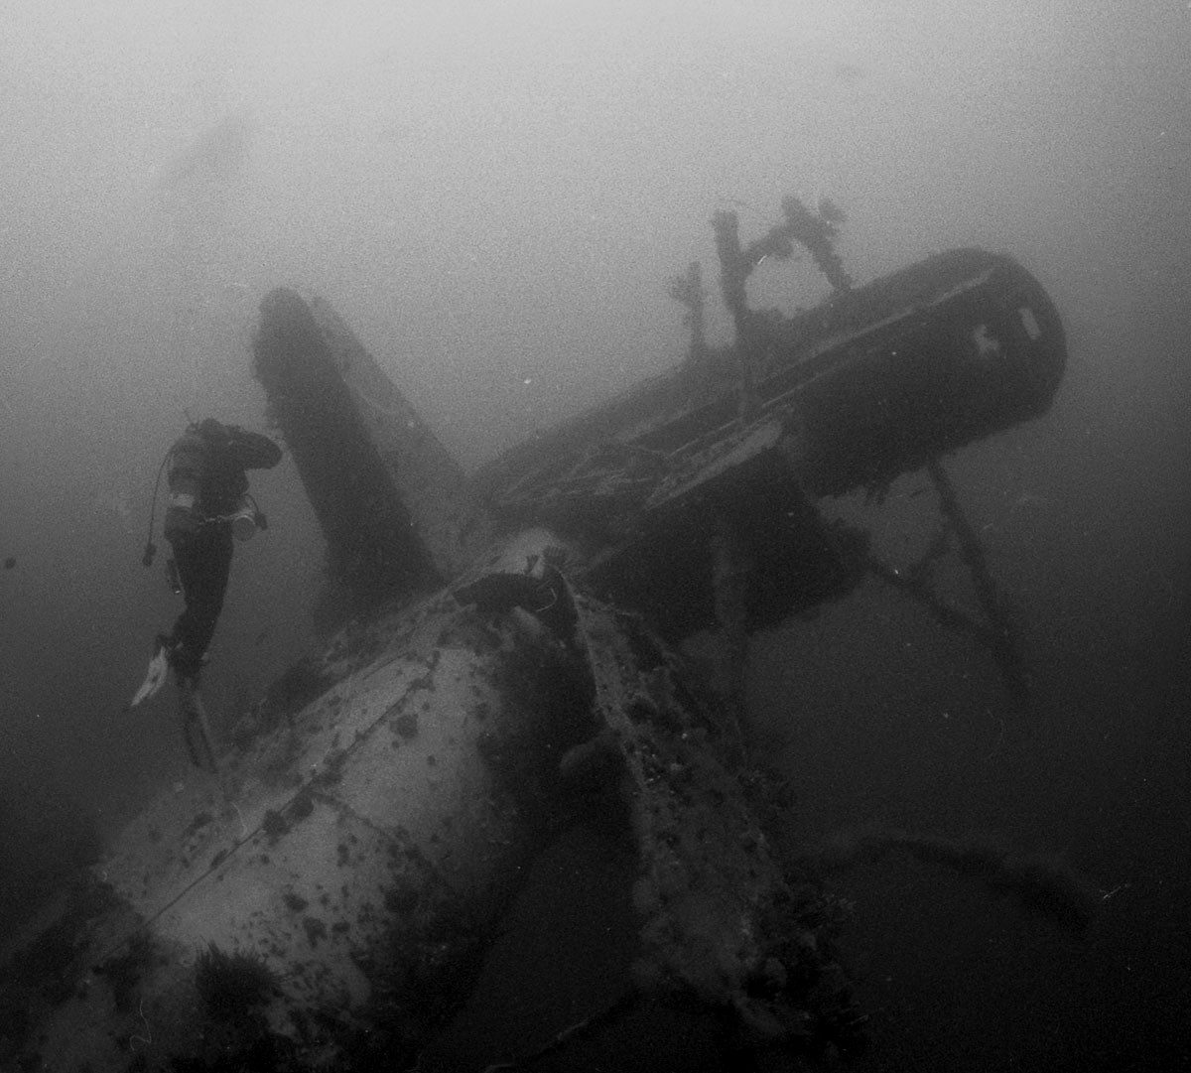
E. Causes of Water pollution
a. What can you see in the pictures?
b. Discuss the causes & effects of water pollution.
c. Describe the remedies of water pollution.

Slide 17
Pair Works
True/False 5
a) The world is not producing millions of tons of domestic rubbish.
b) Air is an important element.
c) Man does not make fire to cook food.
d) Railway engines and powerhouses create smoke.
e) All these kinds of smoke do not pollute the air.
Fill in the blanks with clue. 5
Producing rubbish each toxic difficult
The world is (a)………….millions of tons of domestic (b)……….…. and (c)……………industrial waste (d) …………year. And it is becoming increasingly (e)………..to find suitable locations to get rid of all these refuse.

Slide 18
Group Work
1. In how many ways can smoke be created?
2. Why is it difficult to dispose of waste?
3. What do you think is the main cause of air pollution in your area?
4. How do mills & factories pollute water?
5. How is water polluted in your locality?
6. How can you minimize water pollution in your locality?

Slide 19

Assessment / Evaluation (Oral)
In not more than 5 sentences
Describe the air & water pollution in your words.
Explain how we can minimize pollution.
Analyze the causes & solution of pollution.

Slide 20

Home Work
What do you think is the main cause of air pollution?
2. How is water polluted?
3. Describe how we can solve this pollution problem.

Slide 21
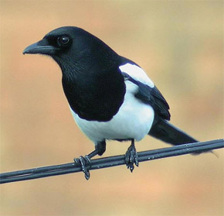
This is the end of today’s English lesson.
Thank you all.

